Slide 1
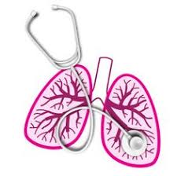
University of Basrah Al-zahraa medical college
Ministry of Higher Education and Scientific Research
Academic year 2021-2022 - S4
Respiratory system module (RS)
Session 3 lecture 1 date 15/3/2022
Gas Exchange and Ventilation of the Lungs
Module staff:
Dr. Nehaya Mnahi [module leader]
Dr. Ahmed Badr
Dr. Nawal Mustafa
Dr.Firas Mohamed
Dr. Mohamed Adil
Dr. Ahmed Jaffer
Dr.Karam Basil
Dr. Amer Qasim
Dr. Ahmed Qassim
Dr. Ahmed Ibrahim
Gannon’s Review of Medical Physiology by Barrett.
Guyton and Hall physiology textbook 2016, Vander s Human physiology 13 ed.
For more detailed instructions, any question, or you have a case you need help in,
please post to the group of session. Images are under Creative Commons Distribution

Slide 2
University of Basrah Al-zahraa medical college
Ministry of Higher Education and Scientific Research
Learning objectives :
1- Define the terms 'Functional Residual Capacity', 'Residual Volume', 'Vital Capacity' and 'Inspiratory Capacity’.
2- Define the terms 'Serial dead space' and 'Physiological dead space' and state in general terms how these variables are measured.
3- Calculate alveolar ventilation rate when given the pulmonary ventilation rate, dead space volume and respiratory rate

Slide 3
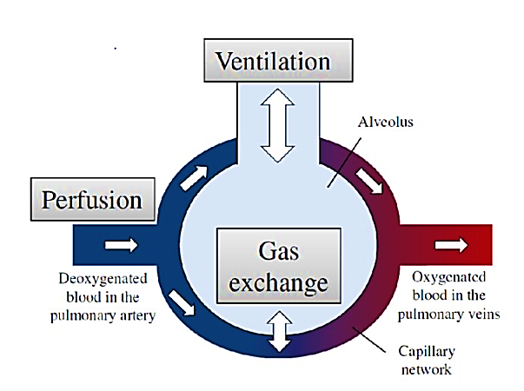
University of Basrah Al-zahraa medical college
Ministry of Higher Education and Scientific Research
The balance between perfusion and ventilation, keeps the partial pressure of oxygen and carbon dioxide in the alveolar gas stable at its normal values of 13.3 kPa and 5.3 KPa respectively.
LO1

Slide 4
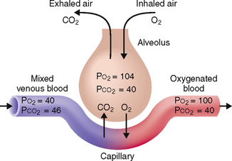
University of Basrah Al-zahraa medical college
Ministry of Higher Education and Scientific Research
Gas exchange O₂: Alveoli blood CO₂: blood 
LO1
(Simple diffusion from high to low concentration)
Pulmonary Artery Blood
Alveolar
Gas
pO₂=~6.0 KPa
pO₂=13.3 KPa
PO2 = 100 mmHg
PCO2 = 40 mmHg
pCO₂=~6.5 KPa
pCO₂=5.3 KPa

Slide 5
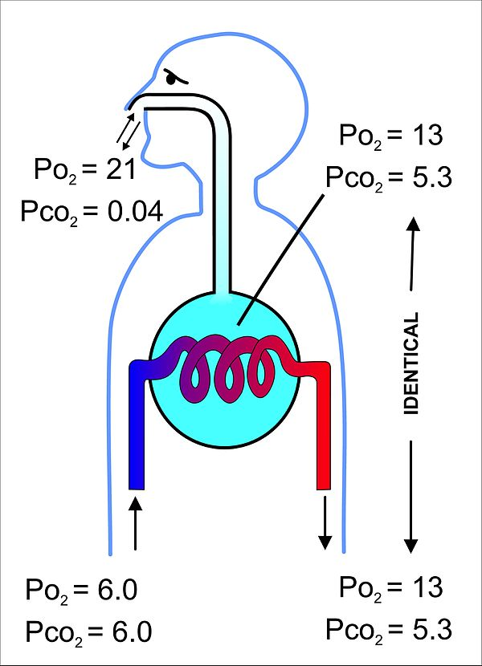
University of Basrah Al-zahraa medical college
Ministry of Higher Education and Scientific Research
Gas Exchange:
LO1
‘Alveolar air’ has a different composition to the atmosphere
less Oxygen
more Carbon Dioxide
The partial pressure of gases in the arterial blood are identical to that in the alveolus.

Slide 6
University of Basrah Al-zahraa medical college
Ministry of Higher Education and Scientific Research
LO1
Reasons for the Difference in the Composition of Atmospheric Air and Alveolar Air:
Water Vapor.
Ventilation.
Perfusion & Gas exchange.
Notes:
Humidification of atmospheric air as it passes through the respiratory passages leads to dilution of gases “Water Vapor”.
Partial replacement of alveolar air by atmospheric air with each breath “Ventilation”.
Constant absorption of O₂ from alveoli to pulmonary capillaries. Diffusion of CO₂ from pulmonary capillaries to alveoli “Perfusion & Gas exchange”.

Slide 7
University of Basrah Al-zahraa medical college
Ministry of Higher Education and Scientific Research
LO1
Gas exchange rate is determined by:
O₂: Alveoli blood CO₂: blood CV
1. Area available for exchange
2. Resistance to diffusion “Alveolo-capillary membrane”
3. Gradient of partial pressure

Slide 8
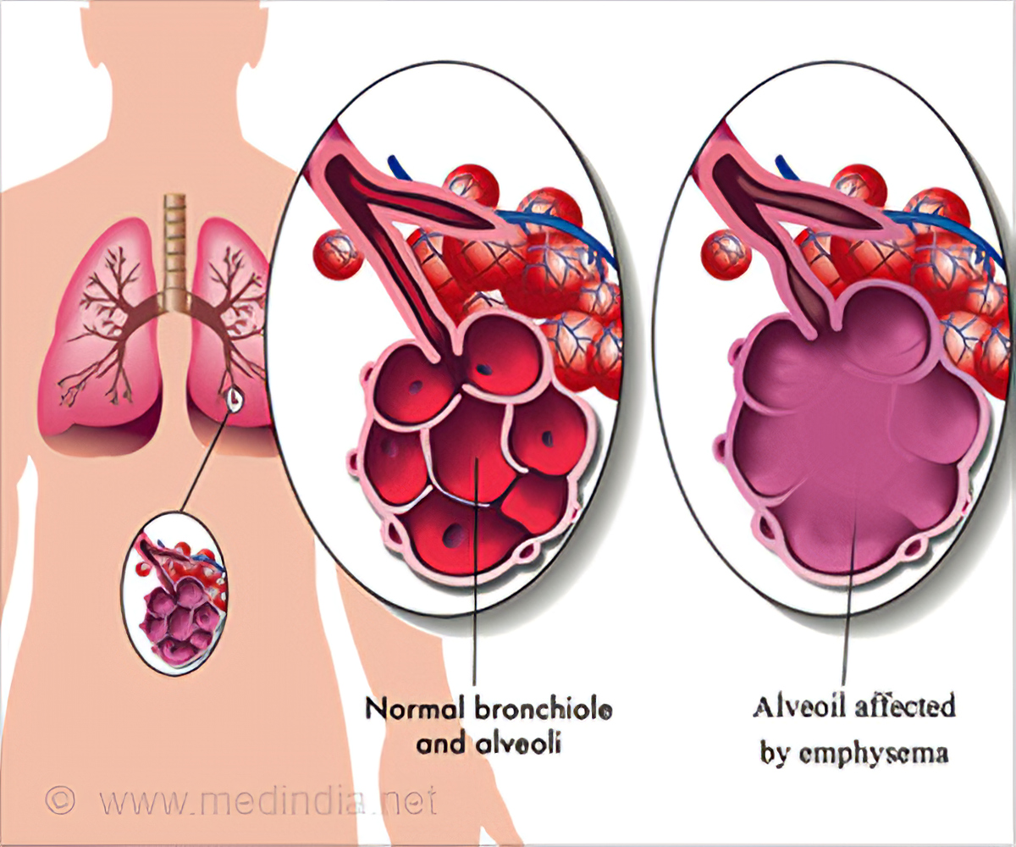
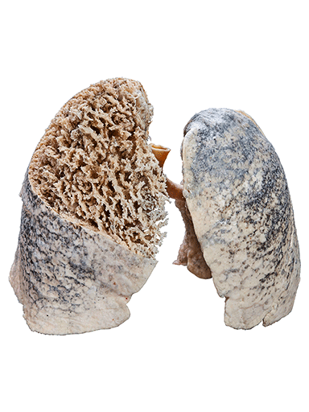
University of Basrah Al-zahraa medical college
Ministry of Higher Education and Scientific Research
1. Area available for exchange
LO1
The area of the alveolar surfaces is large
In normal lungs, the area available is not a limiting factor on gas exchange.
In some disease like emphysema reduce gas exchange and produce low oxygen level

Slide 9
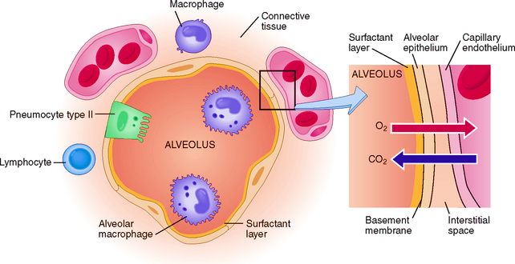
University of Basrah Al-zahraa medical college
Ministry of Higher Education and Scientific Research
2. Alveolo-capillary membrane:
LO1
The diffusion pathway is short, but there are several structures to pass. First gas must diffuse through the gas in the alveoli “Ventilation”, then through:
1.Surfactant
2.The alveolar epithelial cell
3. Interstitial fluid
4. Capillary endothelial cell
5. Plasma
6. Red cell membrane
Despite this, the overall Alveolo-pulmonary barrier thickness is less than 1µm

Slide 10
University of Basrah Al-zahraa medical college
Ministry of Higher Education and Scientific Research
The resistance is not the same for the two gases.
The rate of exchange of O2 is normally very rapid, so that within 0.5second of blood arriving in the alveolar capillary, it will be equilibrated with the gas in the alveoli.
LO1
The rate of diffusion is affected by the solubility of the gas in water, and CO2 diffuses much faster, because it is more soluble (diffuses 21 times as fast as O2 for a given gradient).
This means that anything affecting diffusion will only change O2 transport, as that is limiting factor.
In a normal subject:
PO2 & PCO2 in arterial blood will be the same (identical)as the partial pressures in the alveolar gas.

Slide 11
University of Basrah Al-zahraa medical college
Ministry of Higher Education and Scientific Research
3. Gradient of Partial Pressure:
LO1
To ensure adequate tissue O2 supply and CO2 removal, the PO2 & PCO2 in the alveolar gas must be kept very close to their normal values of 13.3 KPa and 5.3 KPa respectively.
This is achieved by exchange of gas between alveolar gas and atmospheric air brought close to it through the airways “terminal and respiratory bronchioles” of the lung by the process of ventilation.
Fresh atmospheric air does not enter the alveoli, and exchange of O2 and CO2 occurs by diffusion between alveolar gas and atmospheric air in the terminal and respiratory bronchioles.

Slide 12
University of Basrah Al-zahraa medical college
Ministry of Higher Education and Scientific Research
LO1
Alveolar PO2: is determined by a balance between rate of removal of O2 by the blood “Perfusion & Gas exchange” and the rate of replenishment of O2 by “ventilation”.
Alveolar PCO2: is similarly determined by the balance between the rate at which CO2 enters the alveoli from blood “Perfusion & Gas exchange” and the rate at which it is removed from alveolar gas by “ventilation”.

Slide 13
University of Basrah Al-zahraa medical college
Ministry of Higher Education and Scientific Research
Ventilation:
The movement of air between the environment and the lungs via inhalation and exhalation.
Is a process of diffusion of O2 and CO2 between alveolar gas and the fresh atmospheric air in the terminal and respiratory bronchioles.
LO1
Mechanical ventilation
using artificial methods to assist breathing.
Ventilator
a machine designed to move breathable air into and out of the lungs.

Slide 14
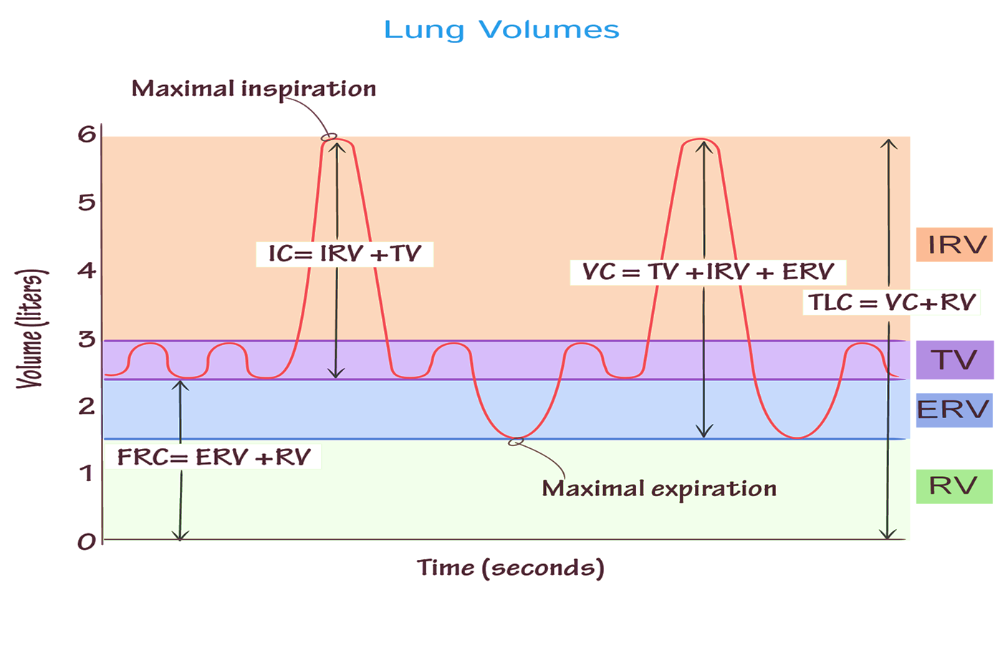
University of Basrah Al-zahraa medical college
Ministry of Higher Education and Scientific Research
LO1
Respiratory Volumes and capacities:
There are no valves in the respiratory system - movement of air is tidal
2100-2300 ml
6000 ml
500ml
1000-1200ml
1200ml

Slide 15
University of Basrah Al-zahraa medical college
Ministry of Higher Education and Scientific Research
Respiratory Volumes:
LO1
*Tidal Volume [TV]: air that moves into and out of the lungs with each breath, approximately 500ml.
*Inspiratory Reserve Volume [IRV]: air that can be inspired forcibly beyond tidal volume, approximately 2100-3200ml.
*Expiratory Reserve Volume [ERV]: air that can be evacuated from the lungs after a tidal expiration 1000-1200ml.
*Residual Volume [RV]: air left in the lungs after a strenuous expiration, about 1200ml, keeps alveoli inflated.

Slide 16
University of Basrah Al-zahraa medical college
Ministry of Higher Education and Scientific Research
Respiratory Capacities:
LO1
*Inspiratory Capacity [IC]: total amount of air that can be inspired after a tidal expiration (IRV + TV).
*Functional Residual Capacity [FRC]: amount of air remaining in the lungs after a tidal expiration (RV + ERV).
*Vital Capacity [VC]: the total amount of exchangeable air (TV+ IRV+ ERV).
*Total Lung Capacity [TLC]: summation of all lung volumes, approximately 6000ml

Slide 17
University of Basrah Al-zahraa medical college
Ministry of Higher Education and Scientific Research
LO1
Measurement of Ventilation:
Use a Spirometer to measure lung volumes and capacities
We cannot however empty our lungs completely, so even after a forced expiration……….?????
The values of lung volumes and capacities are dependent on sex, age, race, state of health.
There are tables to enable you to determine the appropriate value for any individual if you know their age, sex and height.

Slide 18
University of Basrah Al-zahraa medical college
Ministry of Higher Education and Scientific Research
LO2
For a typical adult
Male Female
Tidal Volume 0.5 l 0.5 l
Inspiratory reserve volume 3.3 l 2.2 l
Expiratory reserve volume 1.2 l 1.0 l
Residual Volume 0.8 l 0.7 l
Functional residual capacity 2.0 l 1.7 l
Inspiratory Capacity 3.8 l 2.7 l
Vital Capacity 5.0 l 3.7 l
Total Lung Volume 5.8 l 4.4 l

Slide 19
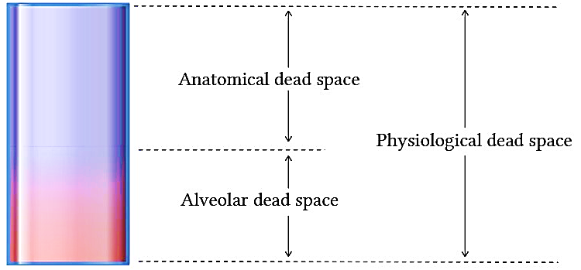
University of Basrah Al-zahraa medical college
Ministry of Higher Education and Scientific Research
LO2
Physiological Dead Space:
The portion of tidal volume that does not take part in gas exchange :
Total “Physiological” dead space = anatomical “serial” dead space + alveolar “functional” dead space

Slide 20
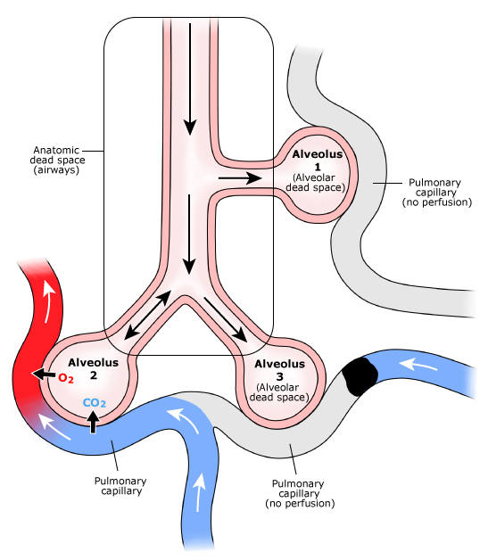
University of Basrah Al-zahraa medical college
Ministry of Higher Education and Scientific Research
Physiological Dead Space:
LO2
1. Anatomical “Serial” Dead Space (ADS):
The volume of the conducting airways (up to and including the terminal bronchiole).
anatomical dead space is 150 mL.
This is measured by the nitrogen washout test.
2. Alveolar “functional” Dead Space:
The air in the non-functioning alveoli (under-perfused or nonperfused alveoli)
Normally alveolar dead space air is about 5-10mL.

Slide 21
University of Basrah Al-zahraa medical college
Ministry of Higher Education and Scientific Research
LO2
Physiological Dead Space:
The physiological dead space can be determined by measuring pCO2 (or pO2) of expired and alveolar air.
Alveolar air is diluted by dead space air to form the expired air.
The degree of dilution is a measurement of the physiological dead space.

Slide 22
University of Basrah Al-zahraa medical college
Ministry of Higher Education and Scientific Research
LO3
Pulmonary Ventilation Rate “PVR”:
The total rate of movement of air into and out of the lungs.
Is composed of two components:
Dead Space Ventilation “DSVR”.
Alveolar Ventilation “AVR”.
PVR = TV x RR
DSVR = DSV x RR
AVR = PVR - DSVR

Slide 23
University of Basrah Al-zahraa medical college
Ministry of Higher Education and Scientific Research
LO3
Alveolar Ventilation Rate:
At each breathe the dead space is fully ventilated.
The deeper the breath the higher the proportion of air available for gas exchange.
Deeper breathing is more effective breathing.
AVR = PVR – DSVR
Or
AVR= TV-ADS x RR

Slide 24
University of Basrah Al-zahraa medical college
Ministry of Higher Education and Scientific Research
Examples:
LO3
In normal quiet breathing:
PVR = TV x RR
0.5 x 14 = 7 L/min.
DSVR = DSV x RR
0.15 x 14 = 2.1 L/min.
AVR = PVR - DSVR
7 – 2.1 = 4.9 L/min.
In slow deep breathing:
If TV=1L & RR=10
PVR = TV x RR
1 x 10 = 10 L/min.
DSVR = DSV x RR
0.15 x 10 = 1.5 L/min.
AVR = PVR - DSVR
10 - 1.5 = 8.5 L/min.
Rapid shallow breathing……..????

